Slide 1
E100
2020.03.31 by Geralt Li

Slide 2
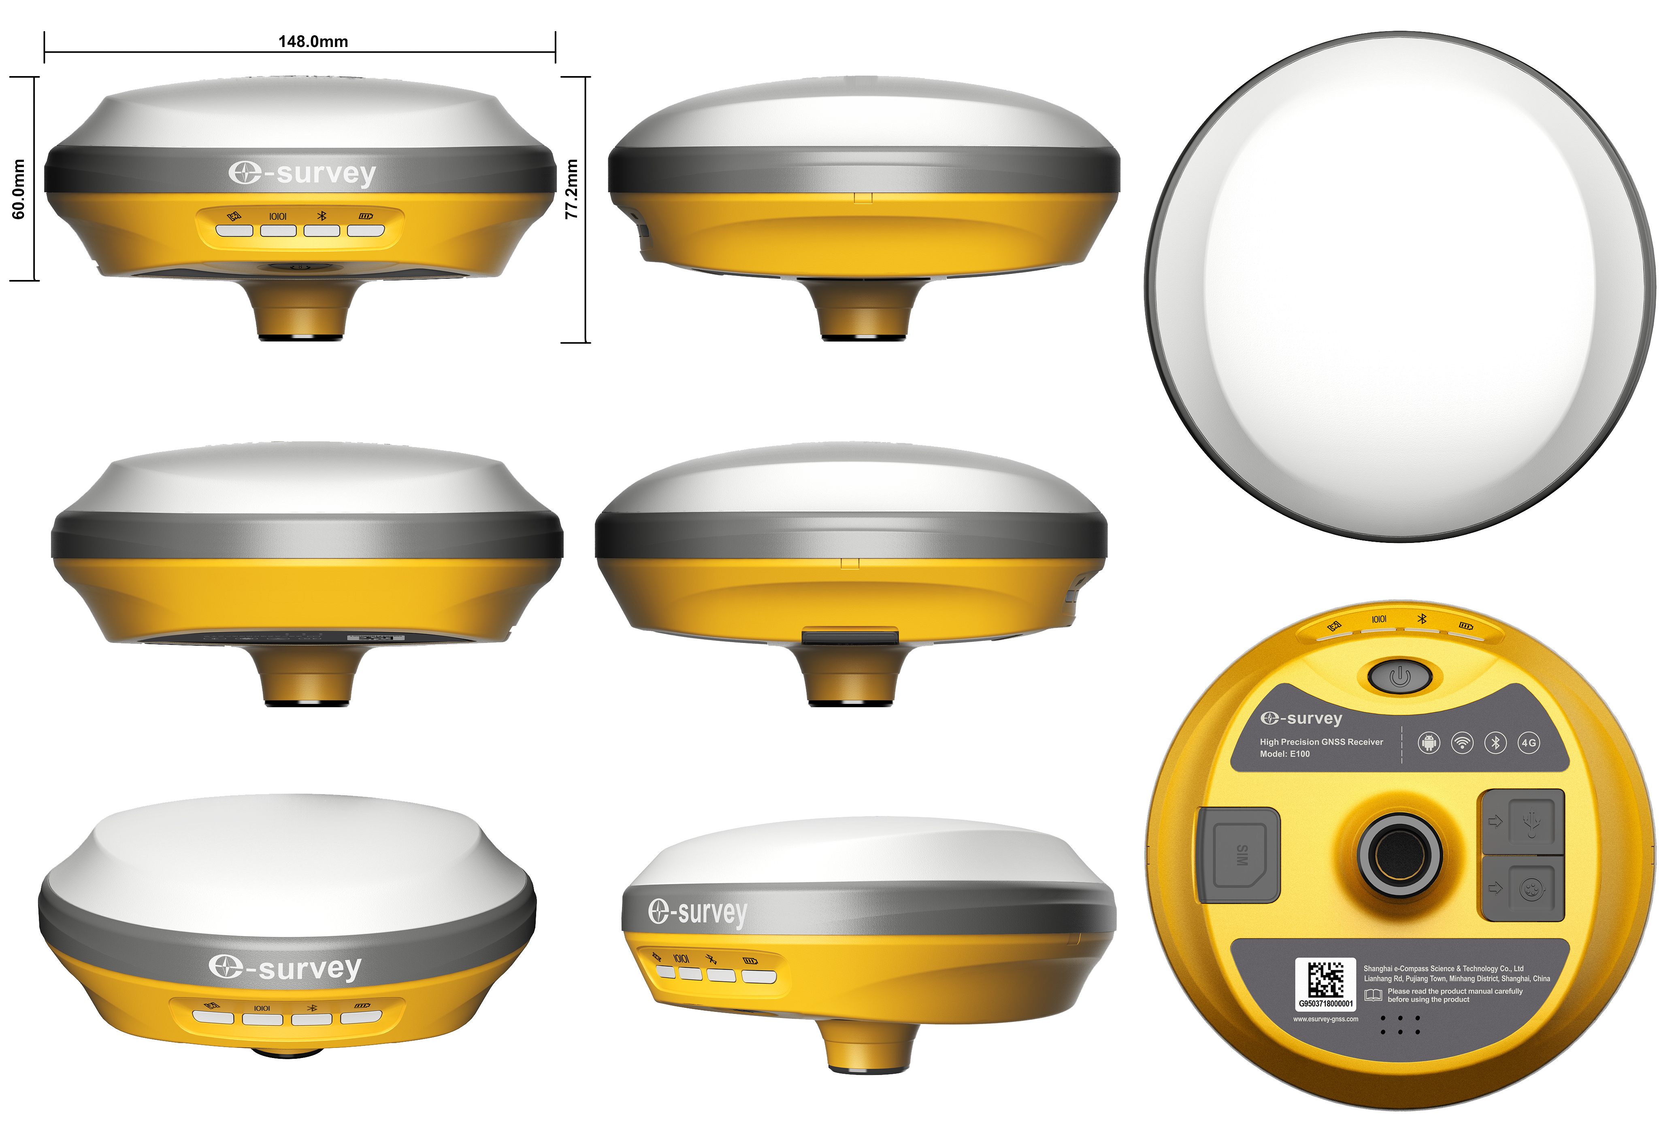
E100
SUMMARY
Overview
Key Features
Specifications
Configurations
Software

Slide 3
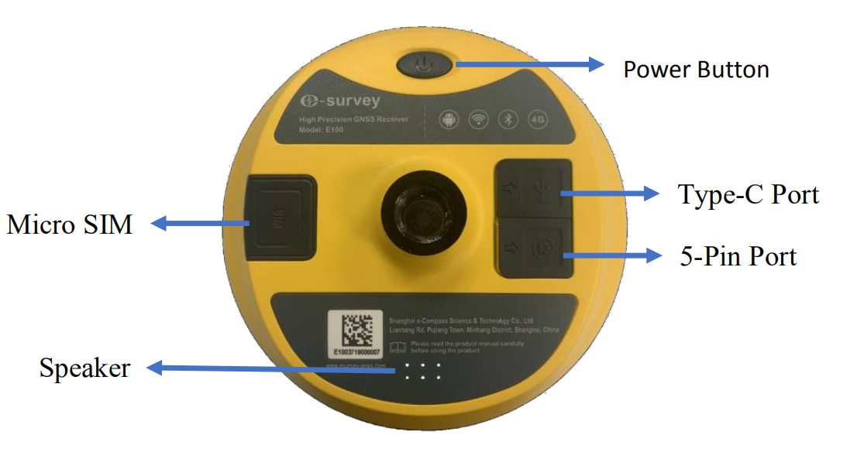
Overview
Φ148mm * 62mm
900g
Internal 4G
Type-C Charge
Build-in Battery

Slide 4
Key Features
All GNSS Signals: 488 channels
GPS
GLONASS
BEIDOU
GALILEO
QZSS

Slide 5
Key Features
Communication
Bluetooth
WIFI
4G Network

Slide 6
Key Features
E-bubble Tilt Survey
E100 is equipped with E-bubble sensor. To collect three different incline angle points, the software will calculate the final result.
No Calibration
Up to 60°
Accuracy <3cm (30°)

Slide 7
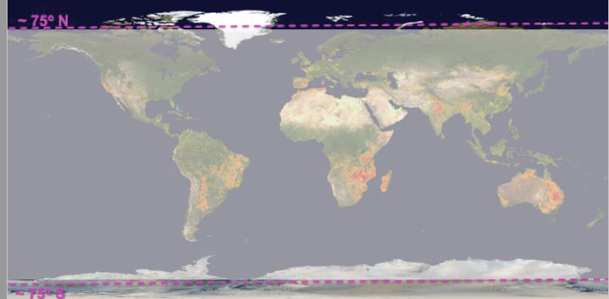
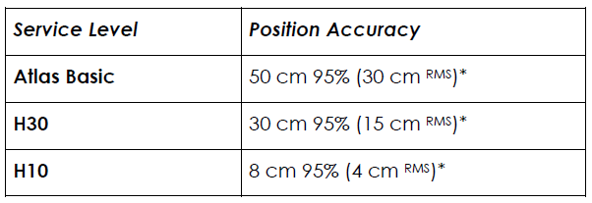
Key Features
ATLAS: GNSS Global Correction Service
Provide both Land Service and Offshore Service

Slide 8
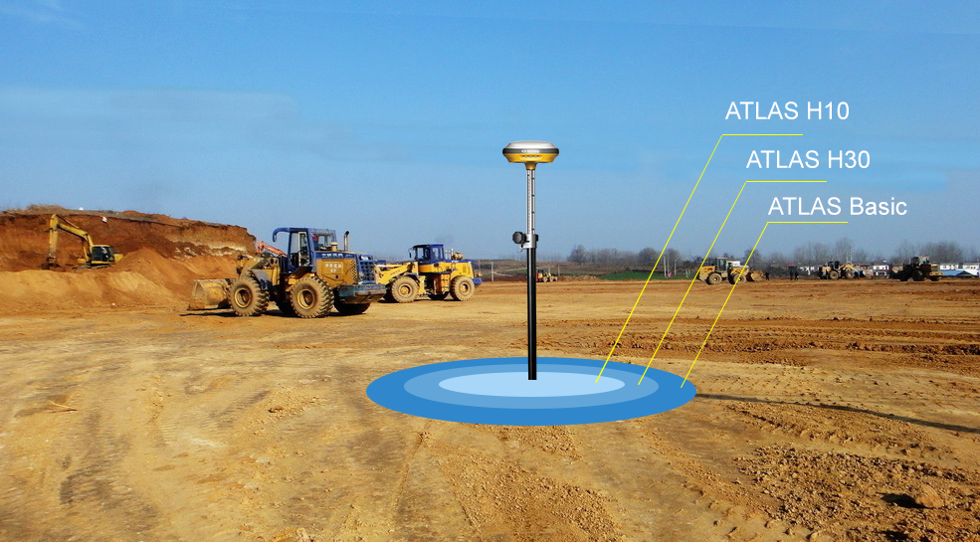
Key Features
ATLAS: GNSS Global Correction Service

Slide 9
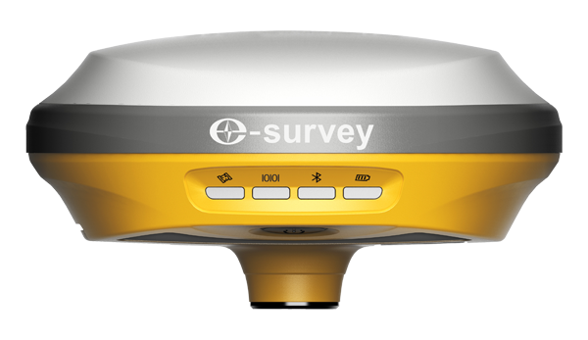
Key Features
aRTK: Free L-Band service
Powered by Atlas, the innovative aRTK technology operates on any Atlas-capable device by enabling it to maintain RTK-level accuracy, availability, and reliability when RTK corrections fail.

Slide 10
Key Features
Build-in Battery
Build-in Li-on Battery
7.2V, 6900mAh
Up to 9 hours
Full charge within 4 hours
Support power bank

Slide 11
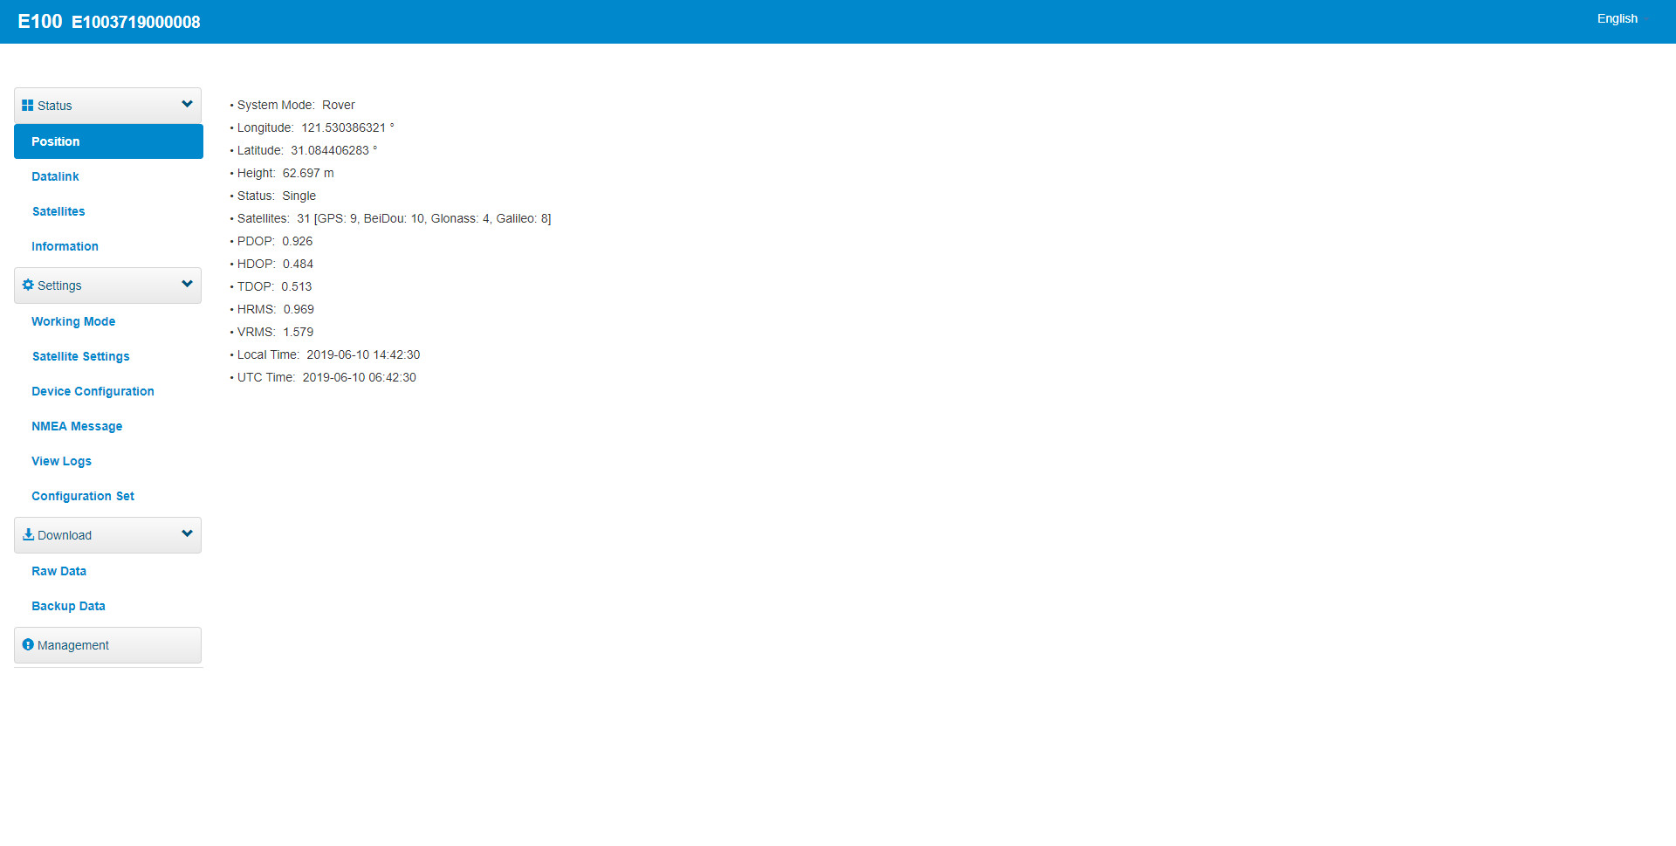
Key Features
Web User Interface
Smart Web User Interface:
Connect PC, phone and tablet
View device status
Setup working mode
Download raw data
Update firmware

Slide 12
Key Features
Additional Features
Smart Voice
IP67
1.2m Drop
-30℃ ~ +65℃
Magnesium Alloy

Slide 13
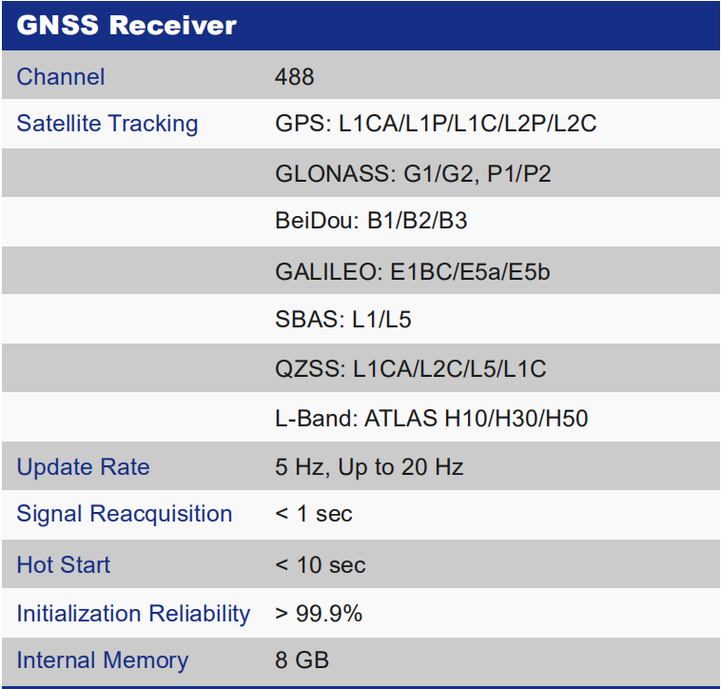
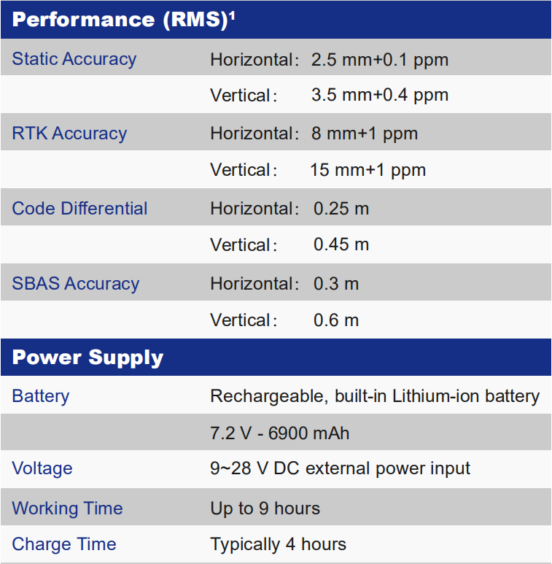
Specifications

Slide 14
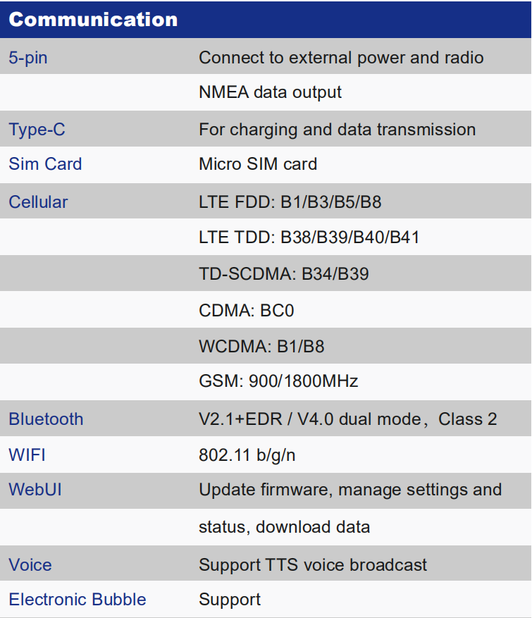
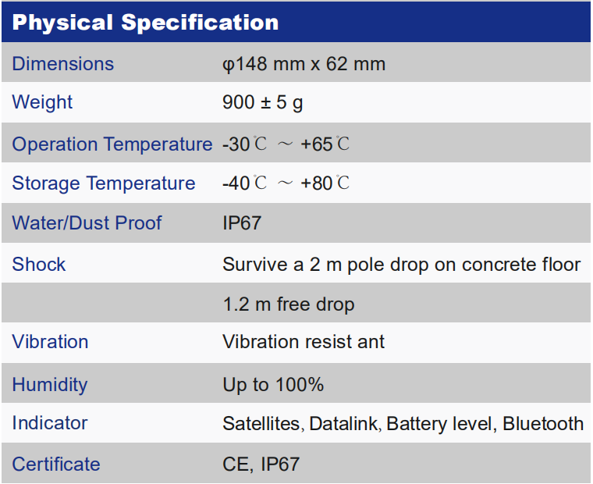
Specifications

Slide 15
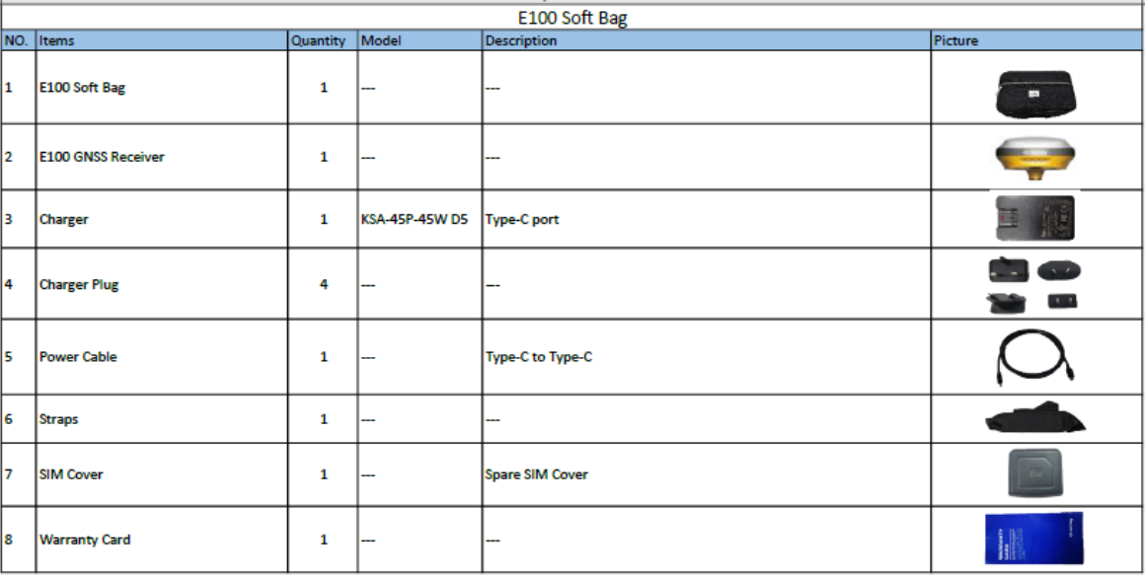
Configurations
E100 base and rover are using the same accessories. We provide easy carrying soft bag or hard carrying case.

Slide 16
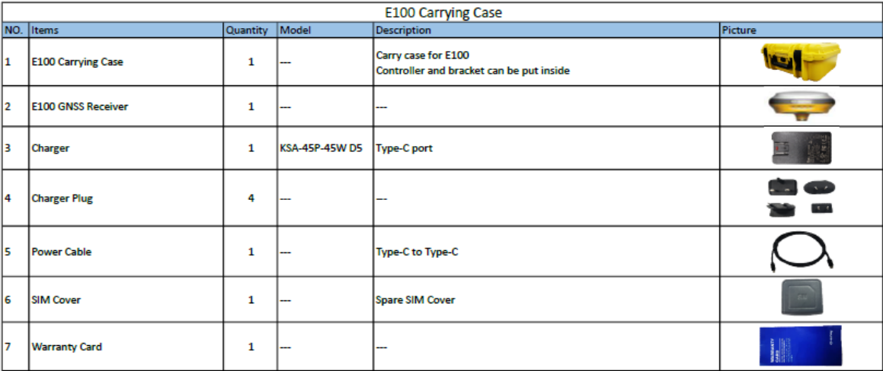
Configurations

Slide 17
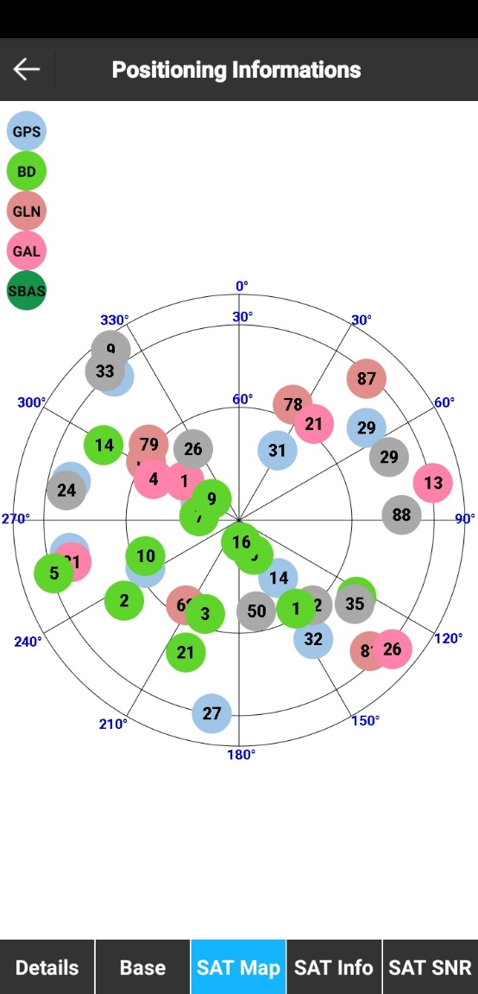
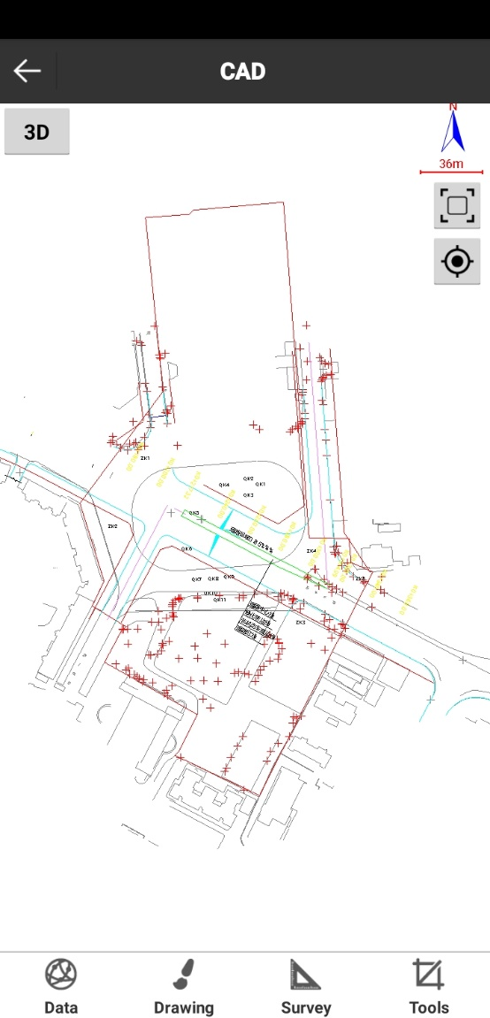
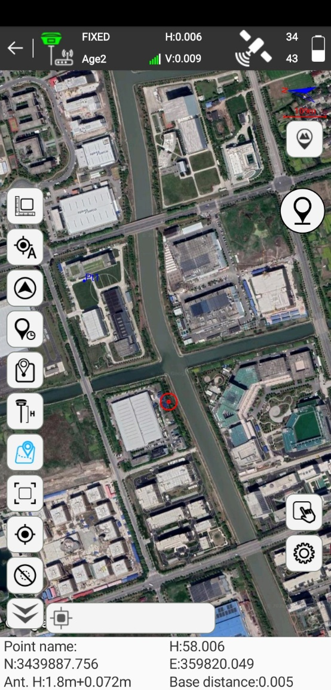
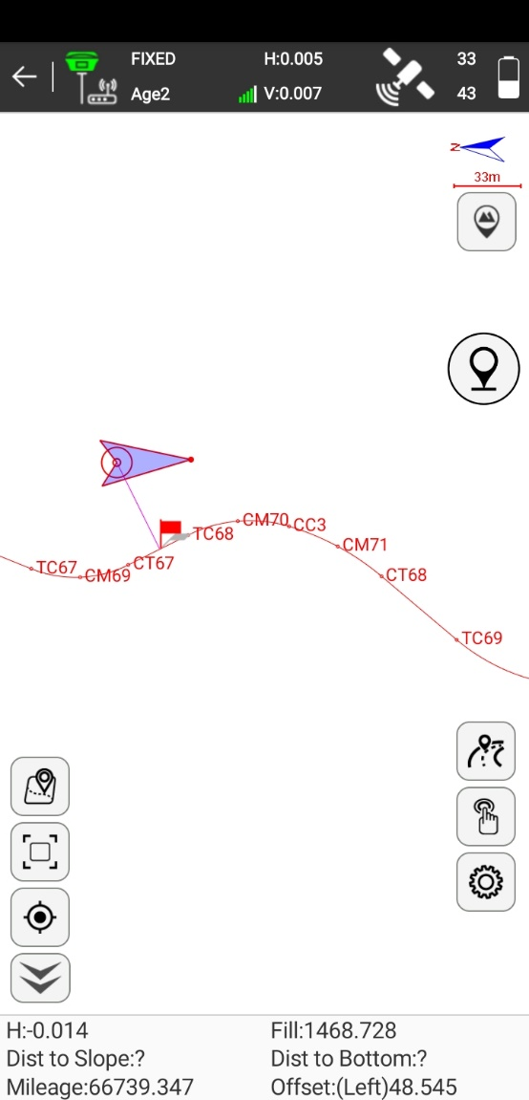
Data Collection Software-SurPad4.0

Slide 18
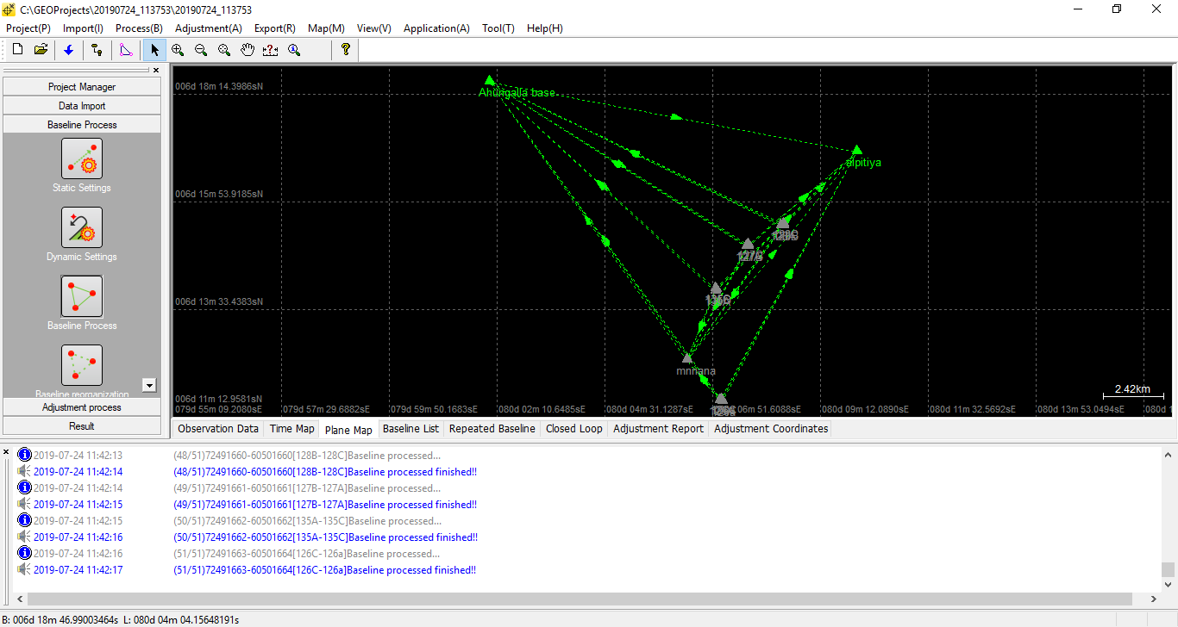
Post Process Software-GEOSolution

Slide 19
THANK YOU
WWW.ESURVEY-GNSS.COM

