Slide 1
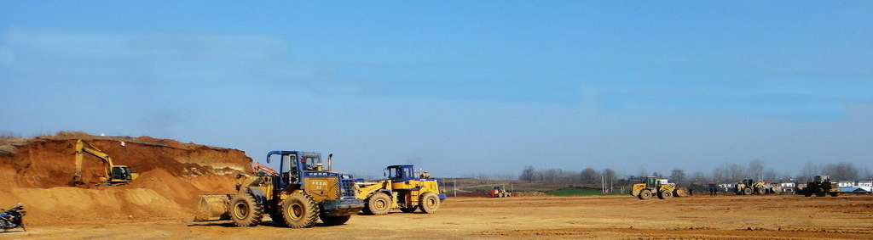

E300 Pro
2020.03.23 by Frank Li

Slide 2

E300 Pro
SUMMARY
Overview
Key Features
Specifications
Configurations
Software

Slide 3
Overview
Φ158mm * 53mm
940g
Internal Radio
Internal 4G
Type-C Charge
Build-in Battery

Slide 4






Key Features
All GNSS Signals: 800 channels
GPS
GLONASS
BEIDOU
GALILEO
QZSS

Slide 5




Key Features
Communication
Bluetooth
WIFI
4G Network
Radio

Slide 6

Key Features
IMU Tilt Survey
E300 Pro is equipped with IMU sensor.
Fast initialization
Tilt to go
Tilt stakeout
Up to 60°
Accuracy <3cm
Free from magnetic interference

Slide 7

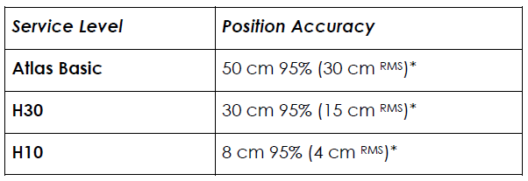

Key Features
ATLAS: GNSS Global Correction Service
Provide both Land Service and Offshore Service

Slide 8
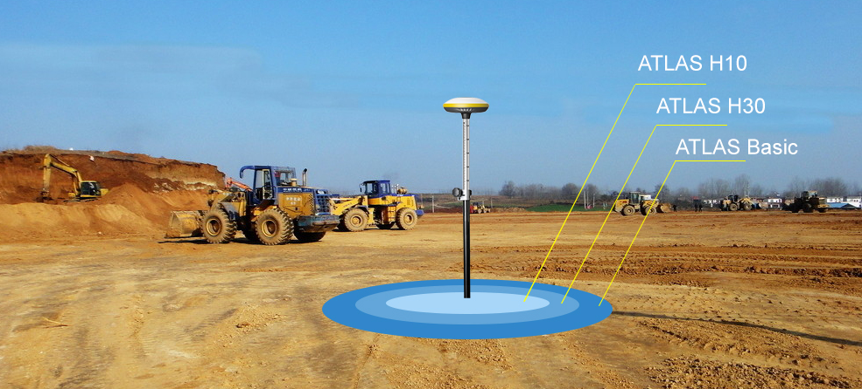
Key Features
ATLAS: GNSS Global Correction Service

Slide 9





Key Features
aRTK: Free L-Band service
Powered by Atlas, the innovative aRTK technology operates on any Atlas-capable device by enabling it to maintain RTK-level accuracy, availability, and reliability when RTK corrections fail.

Slide 10

Key Features
Smart Battery Indicator
Press power button to check battery level without power on device.

Slide 11

Key Features
Build-in Battery
Build-in Li-on Battery
7.2V, 6800mAh
Up to 12 hours
Full charge within 4 hours
Support power bank

Slide 12
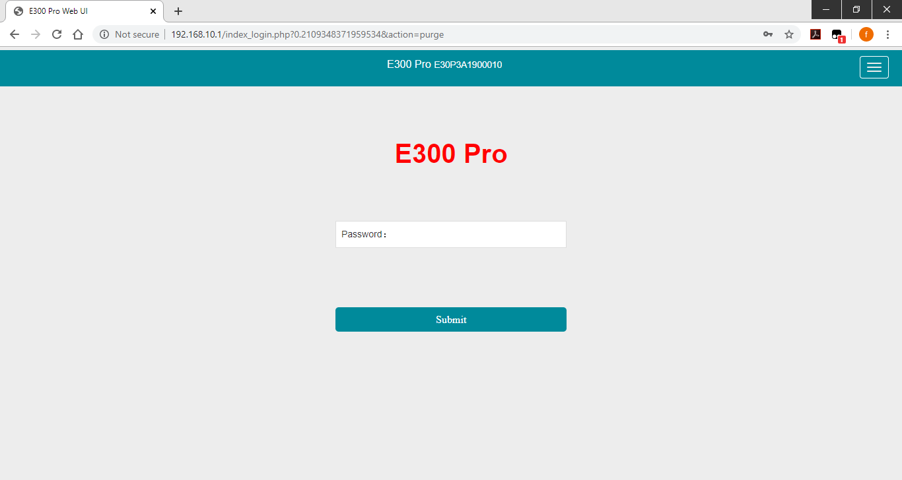
Key Features
Web User Interface
Smart Web User Interface:
Connect PC, phone and tablet
View device status
Setup working mode
Download raw data
Update firmware

Slide 13





Key Features
Additional Features
Smart Voice
IP67
1.2m Drop
-30℃ ~ +65℃
Magnesium Alloy

Slide 14
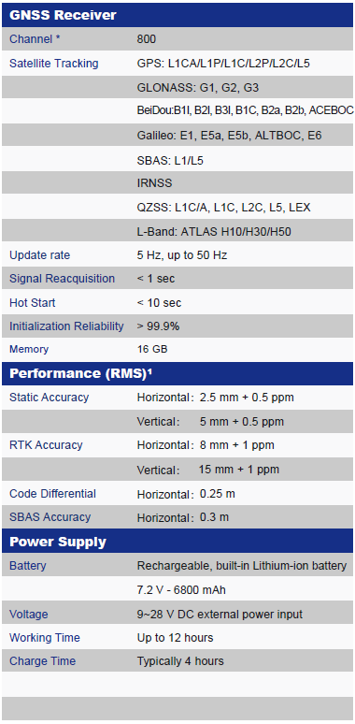
Specifications

Slide 15
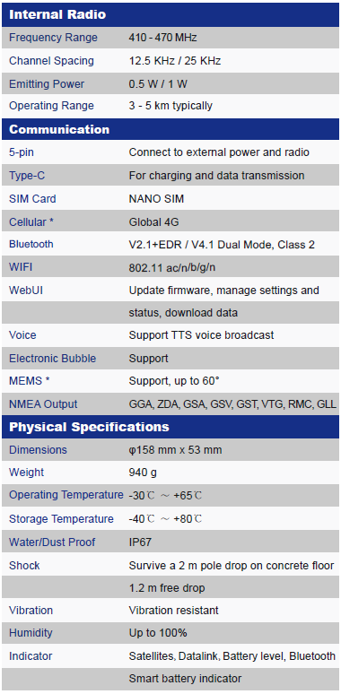
Specifications

Slide 16
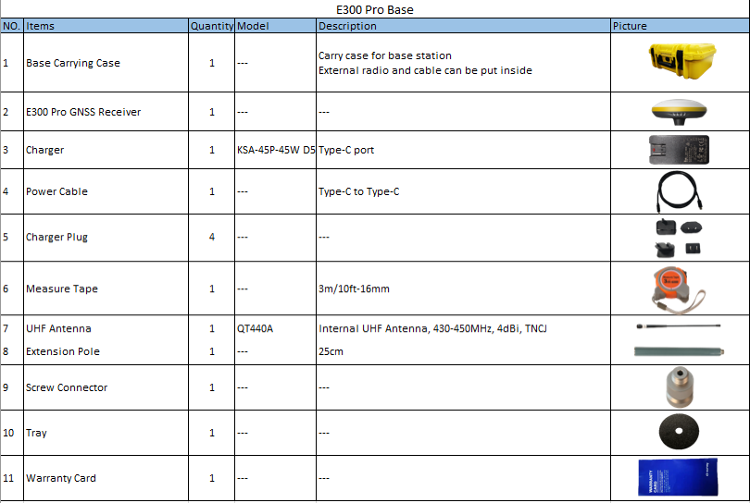
Configurations

Slide 17
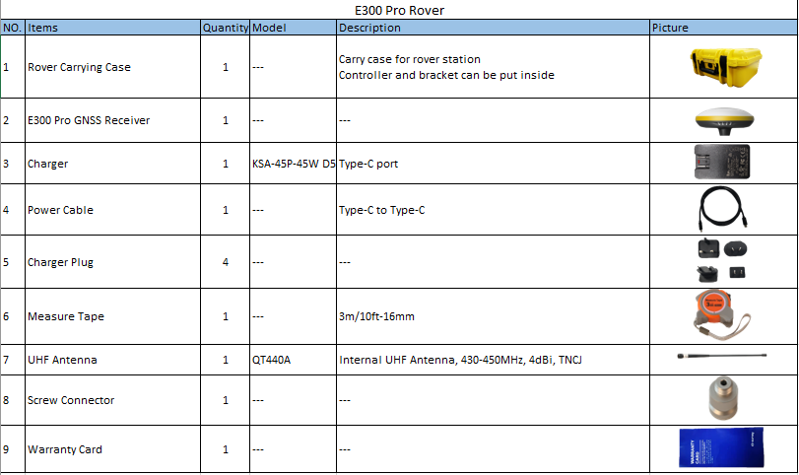
Configurations

Slide 18
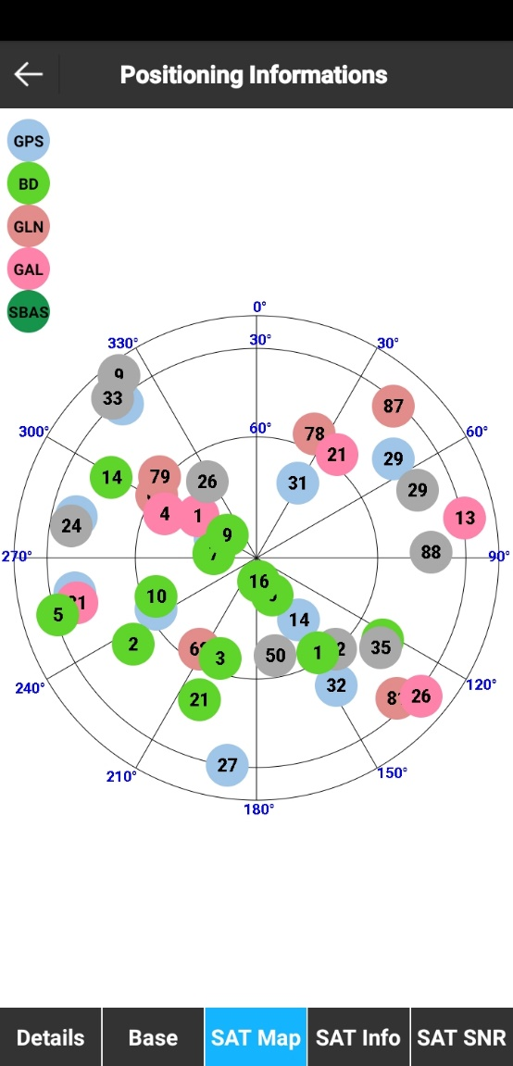

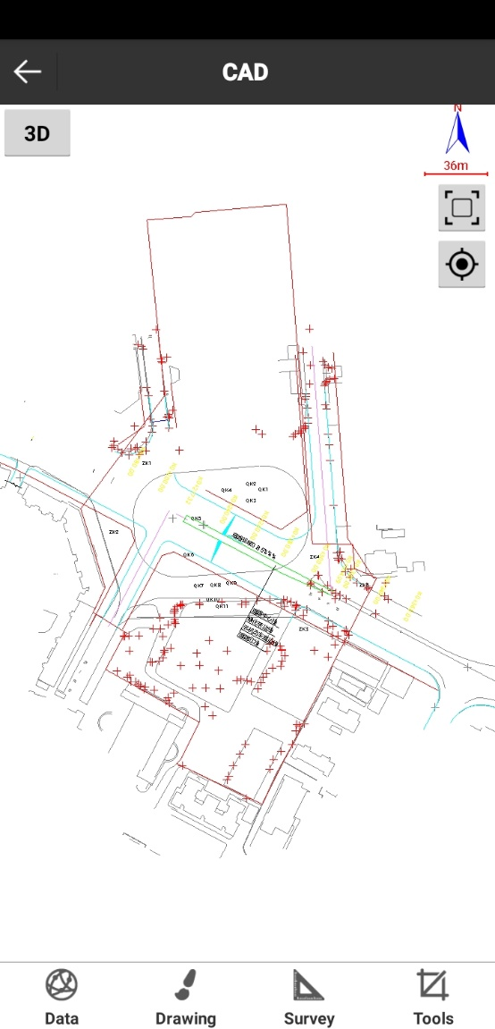
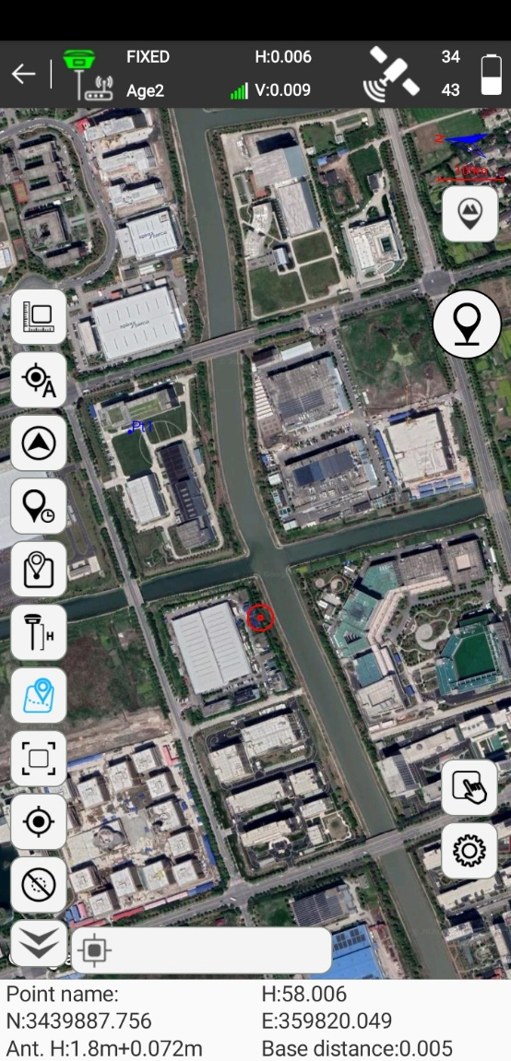
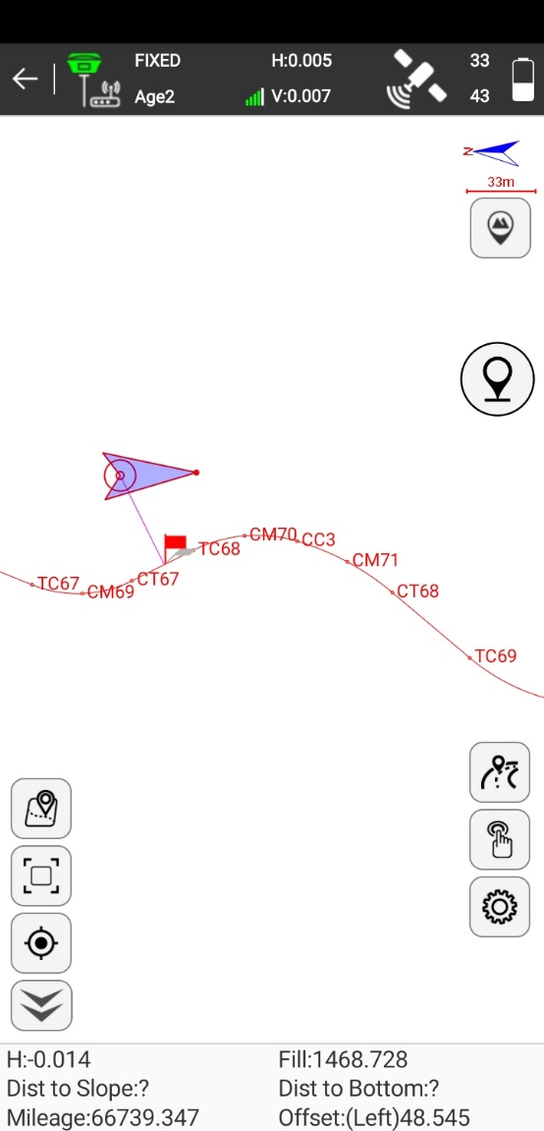
Data Collection Software-SurPad4.0

Slide 19
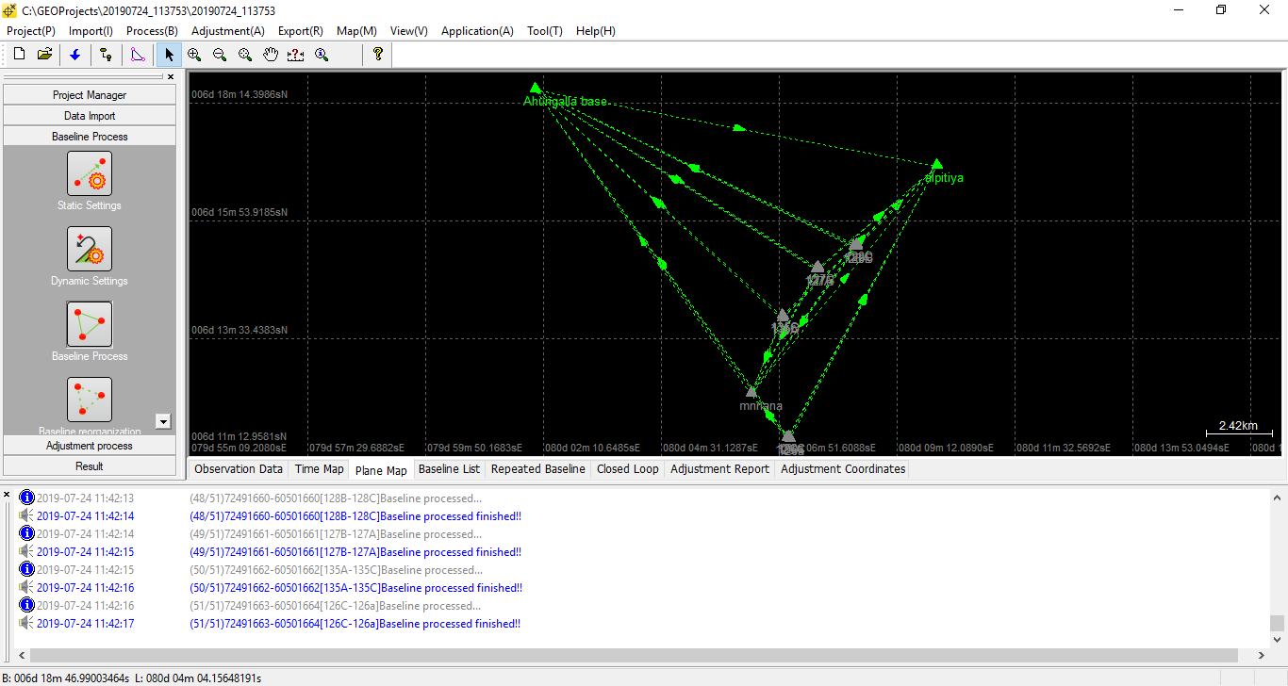
Post Process Software-GEOSolution

Slide 20

THANK YOU
WWW.ESURVEY-GNSS.COM

