Slide 1
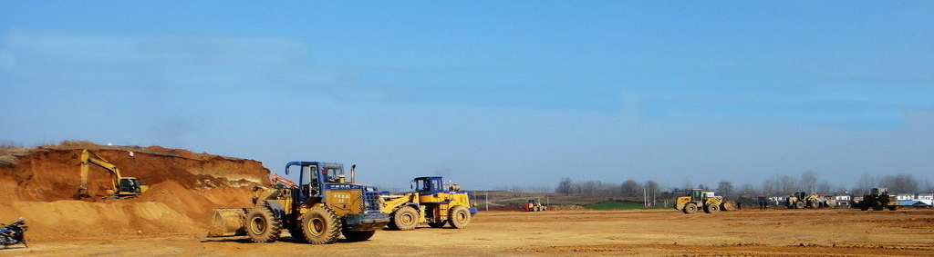

E800
2020.03.23 by Frank Li

Slide 2

E800
SUMMARY
Overview
Key Features
Specifications
Configurations
Software

Slide 3
Overview
154mm * 154mm * 76mm
1.5Kg
5W Radio
Internal 4G
Type-C Charge
Build-in Battery

Slide 4






Key Features
All GNSS Signals: 336 channels
GPS
GLONASS
BEIDOU
GALILEO
QZSS

Slide 5




Key Features
Communication
Bluetooth
WIFI
4G Network
Radio

Slide 6


Key Features
Internal 5w Radio
Powerful Internal Radio Modem:
2W/5W adjustable
Up to 10Km Typically
Support common used protocols

Slide 7

Key Features
Colorful Touch Screen
Colorful Touch Screen:
1.45-inch LCD screen
Colorful display
Touchable
Support working mode configuration

Slide 8

Key Features
IMU Tilt Survey
E800 is equipped with IMU sensor.
Fast initialization
Tilt to go
Tilt stakeout
Up to 60°
Accuracy <3cm
Free from magnetic interference

Slide 9

Key Features
Build-in Battery
Build-in Li-on Battery
7.2V, 13600mAh
Up to 15 hours
Full charge within 5 hours
Support power bank

Slide 10
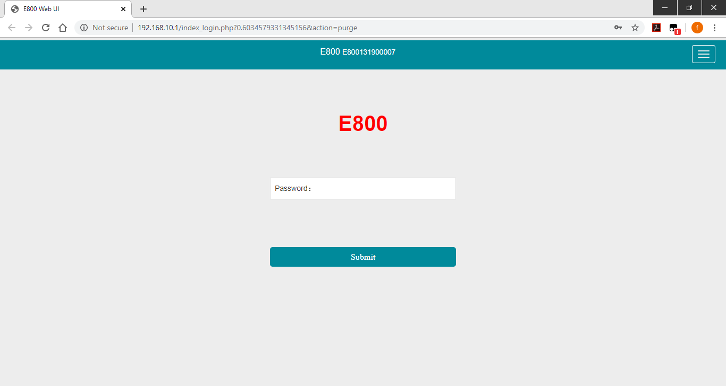
Key Features
Web User Interface
Smart Web User Interface:
Connect PC, phone and tablet
View device status
Setup working mode
Download raw data
Update firmware

Slide 11






Key Features
Additional Features
Smart Voice
IP67
1.2m Drop
-30℃ ~ +65℃
Magnesium Alloy
32GB Memory

Slide 12
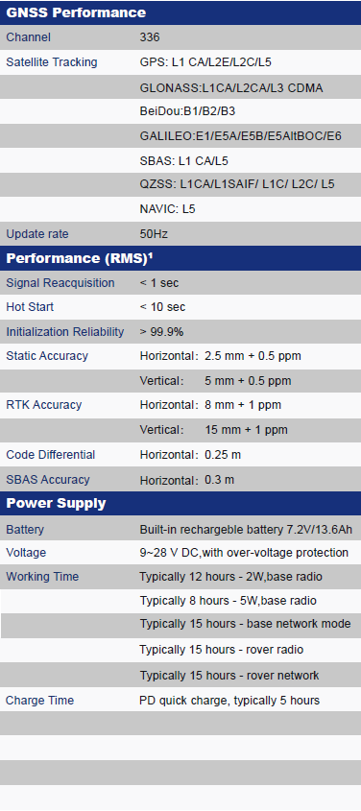
Specifications

Slide 13
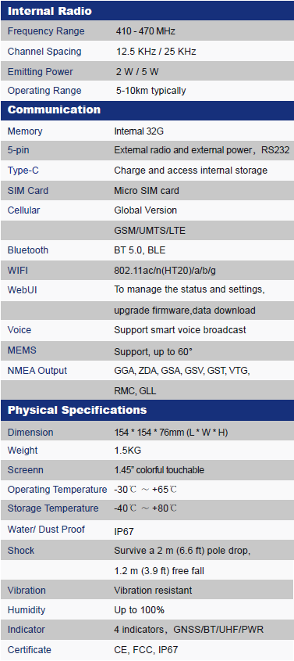
Specifications

Slide 14
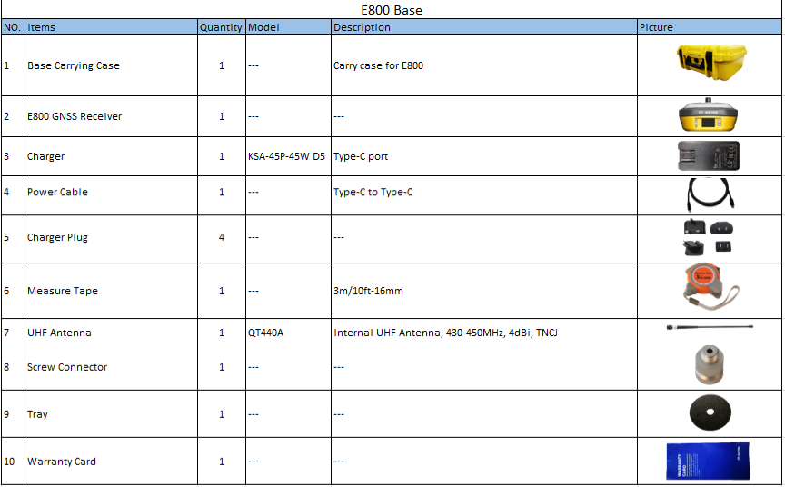
Configurations

Slide 15
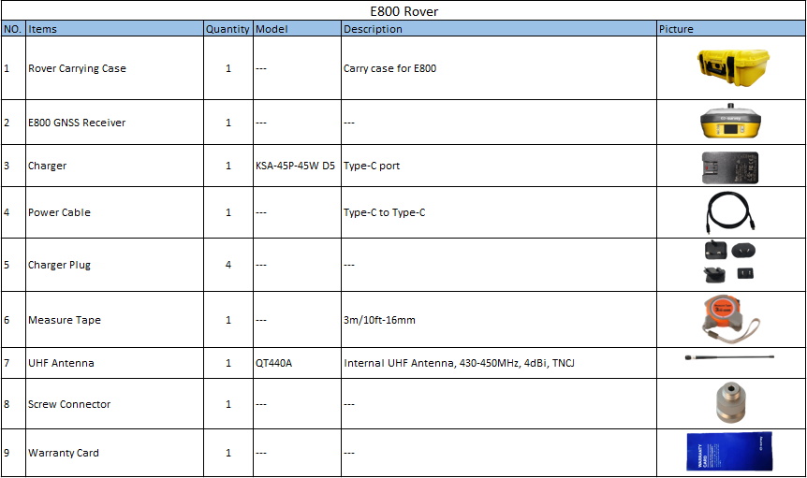
Configurations

Slide 16
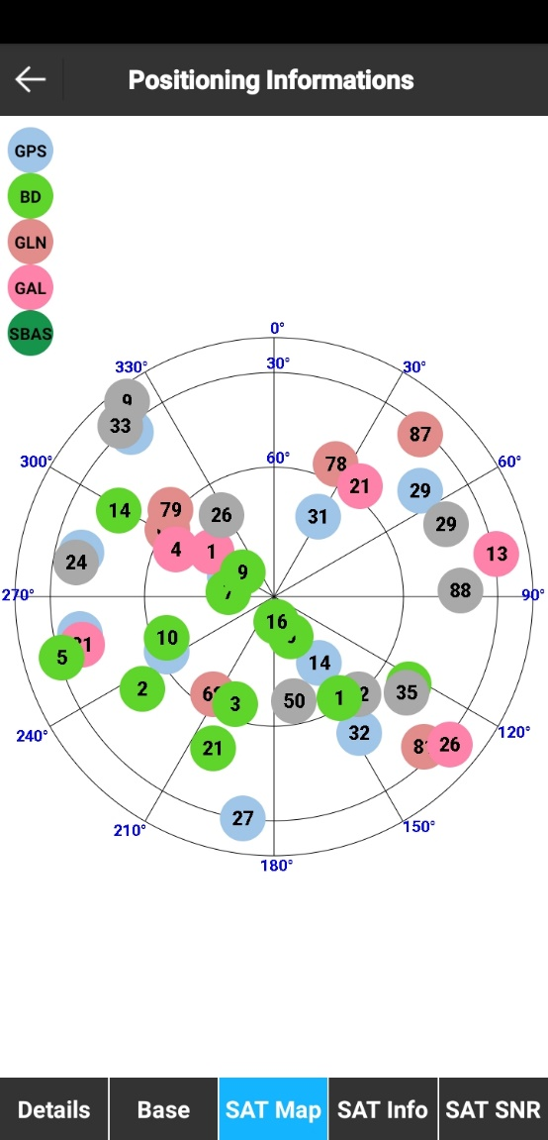

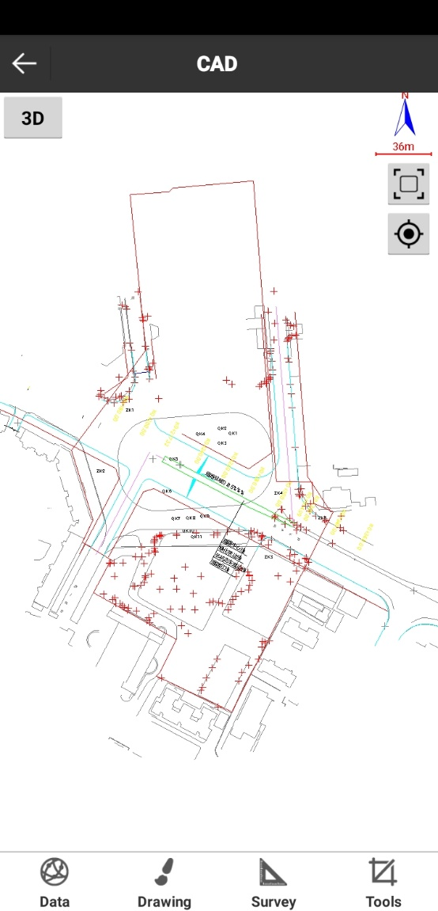
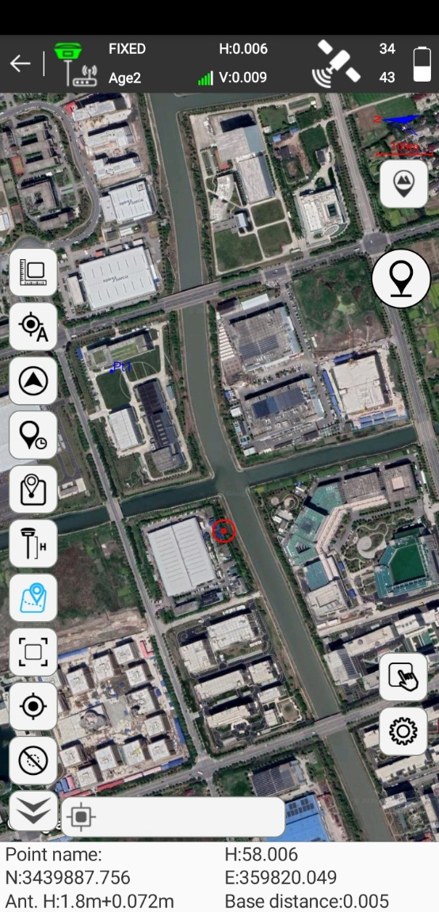
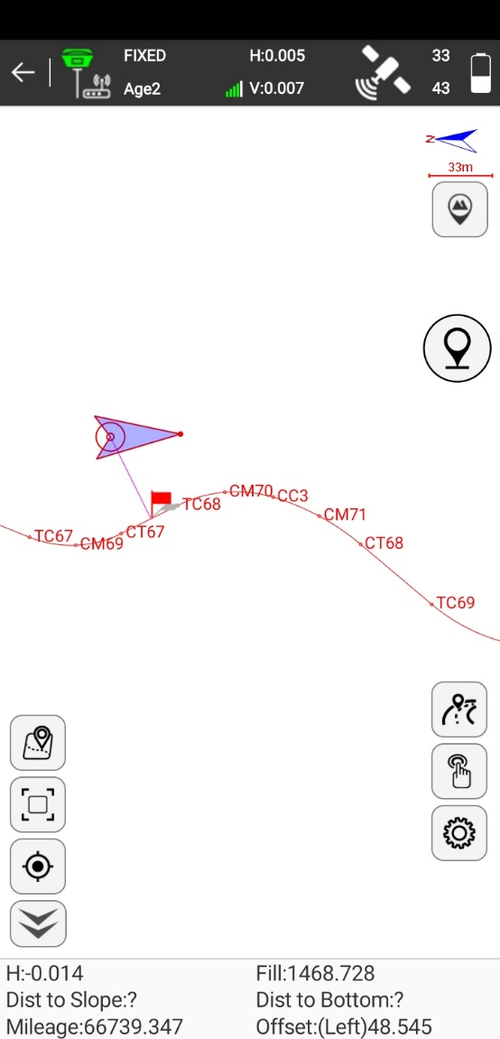
Data Collection Software-SurPad4.0

Slide 17
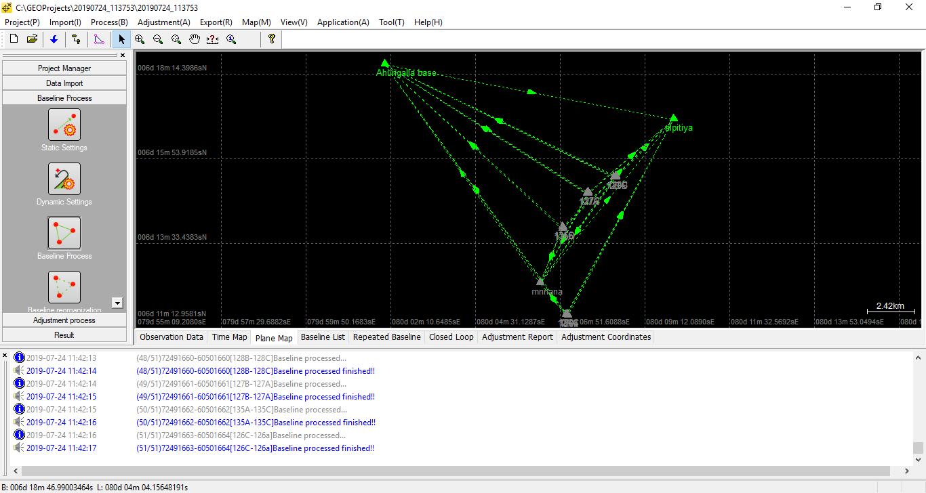
Post Process Software-GEOSolution

Slide 18

THANK YOU
WWW.ESURVEY-GNSS.COM

